Slide 1


Slide 2


Slide 3
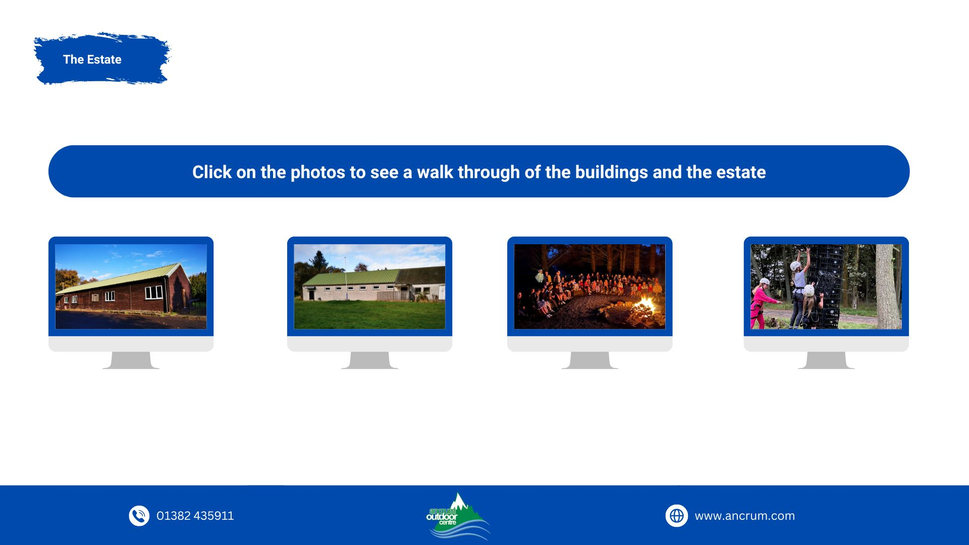
Carolina Lodge
Larg Lodge
The Campfire
Douglaswood Estate

Slide 4


Slide 5
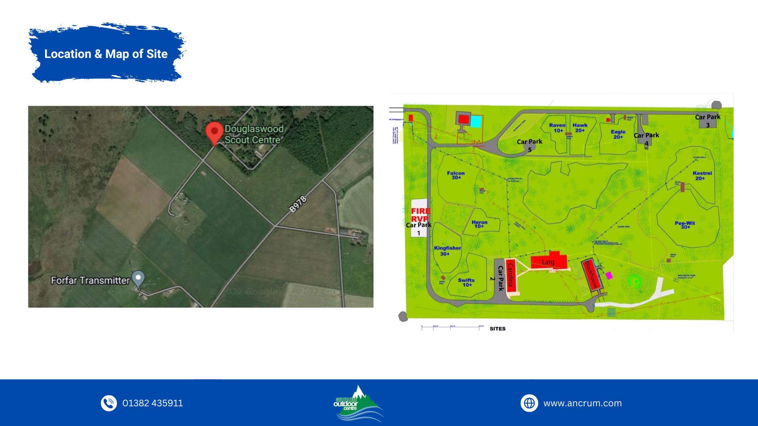

Slide 6
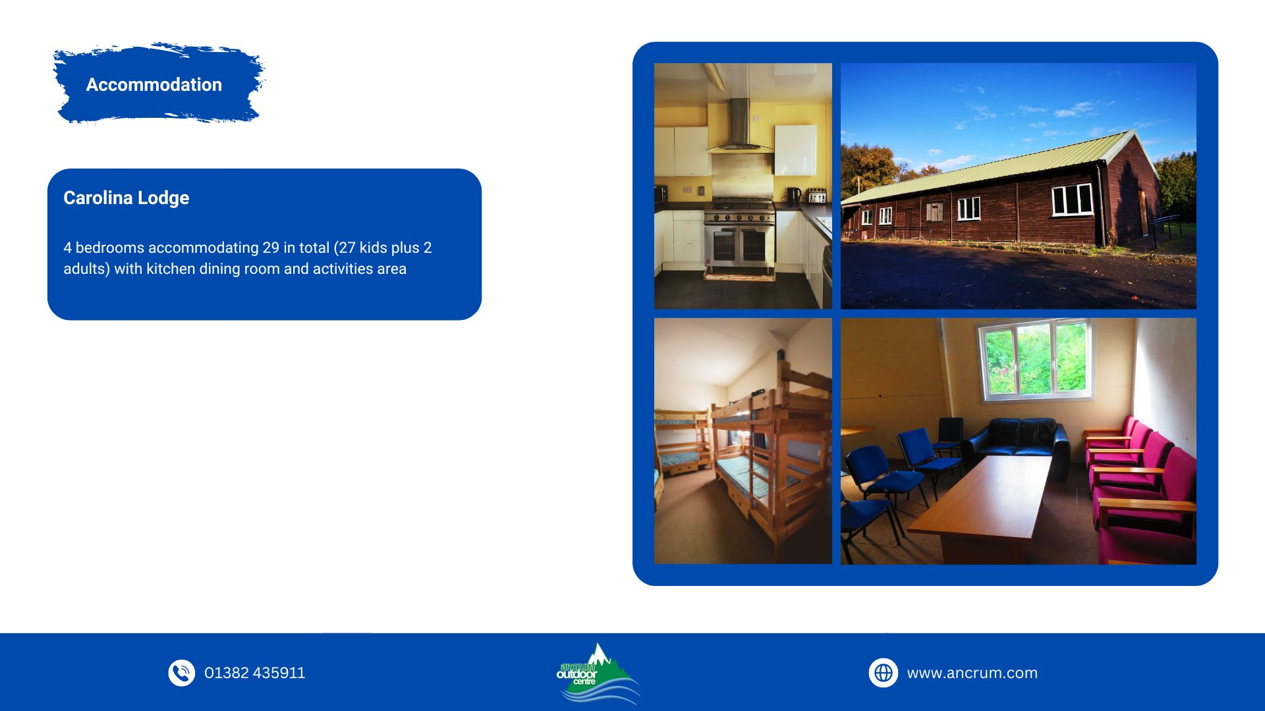

Slide 7
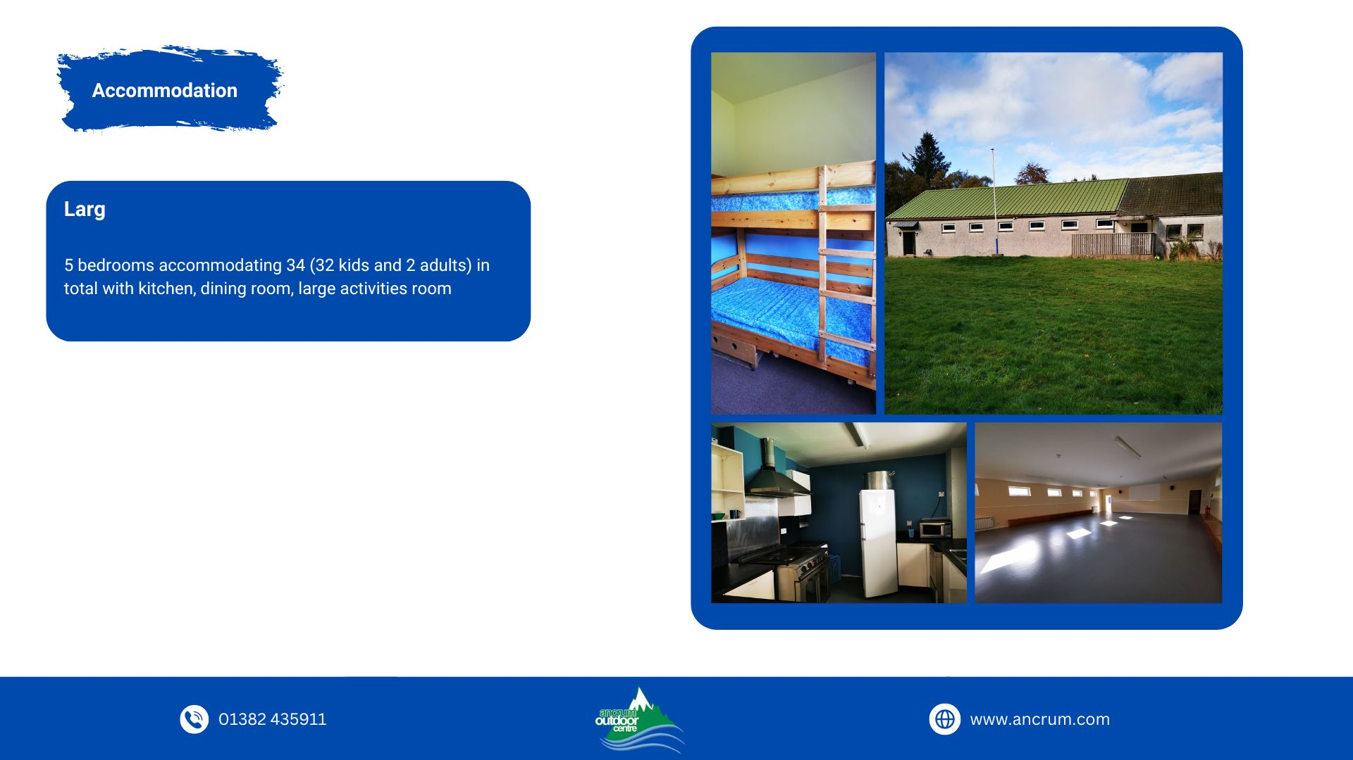

Slide 8
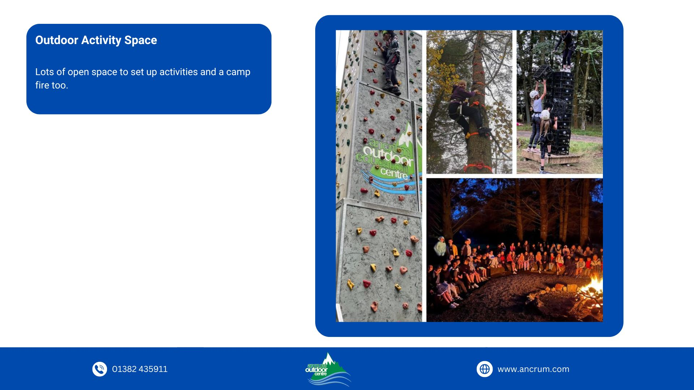

Slide 9
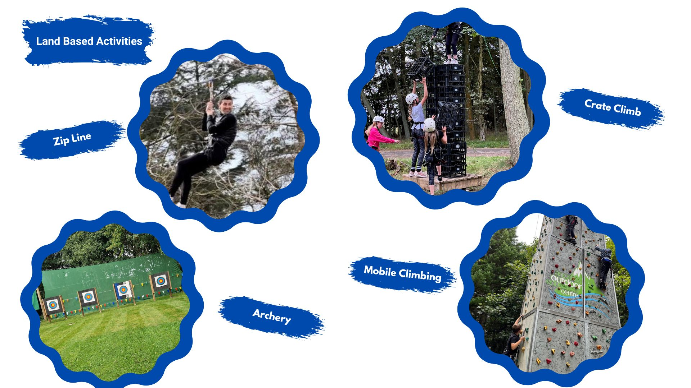

Slide 10


Slide 11
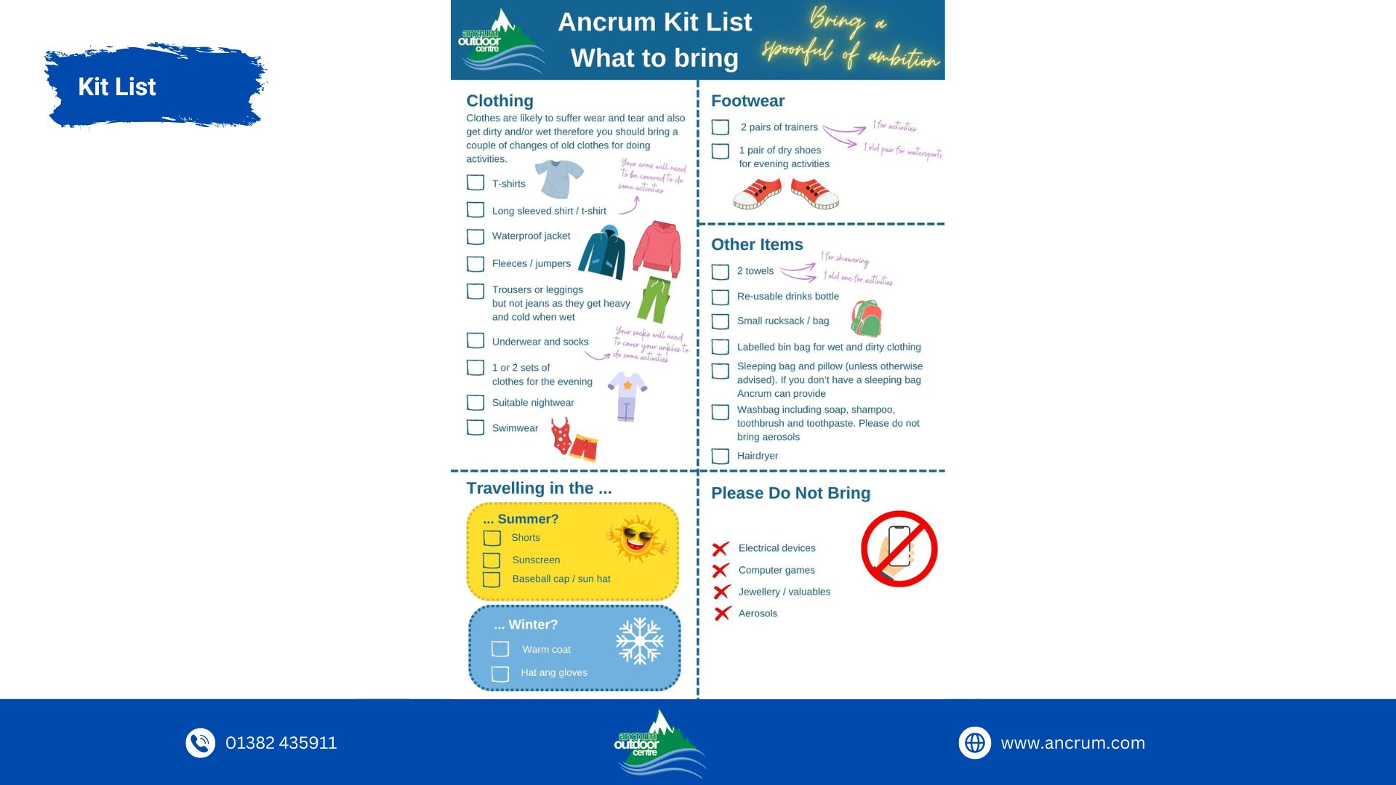

Slide 12

Information to be returned
Ancrum Parental Consent Form
School to confirm any other paperwork

Slide 13
Medication
If your child will require any form of medication whilst on the trip, please fill out the appropriate form:
  Form ?– Parental request for pupil to self-administer medication (inhaler, antihistamine, cream etc)
  Form ? – Parental request for staff to administer medication (prescribed medicine)
Medication to be self-administered should be kept by the child but Form must be handed to ( teachers name) before or on the morning of the trip.
Medication cannot be accepted without a form ?– no medicine can be brought to the trip without a form.
ALL medication which needs to be administered by staff should be handed to ( teachers name) before the trip (with form).
(teachers name) will be available on (time and date) to collect ALL medication to be administered by staff (with Form).
Please use this time to discuss the medication routine with:
Medication to be administered by staff must be in the box with the label on.

Slide 14
Money
Children can bring a maximum of £5 spending money in coins.
All tuckshop monies to be held by school staff
All items £1 each
A sheet with a list of names and total spent shall be collected by staff running tuckshop and any unspent funds returned to pupil by school staff.

Slide 15
Dietary Requirements
Please come to speak to us at the end of the information talk to make us aware of any food allergies or dietary requirements.
This should also be recorded on the parent/guardian consent form.

Slide 16
Extra Snacks and Juice
Children can bring extra snacks and juice to the trip if they want to.
Children will be provided with breakfast, lunch and evening meal.
We will try our best to accommodate everyone's preferences however, with a large group, this may prove difficult especially if your child is fussy.
If your child is a fussy eater, please provide them with snacks that you know they will eat.
Children will be busy and on the go all day – please remind your child that they will be expected to eat at meal times.

Slide 17
Extra Belongings
Cards
Football
Boardgames
Nothing electrical or expensive

Slide 18
Emergency Contact
Children will not be making contact with people at home during the trip.
If you need to contact your child during the trip, please call the school office who will contact the trip leader.
Please only make contact while the children are on the trip if it is an emergency.

Slide 19
Emergency Contact
The information you have provided on the consent form will be used as our emergency contact.
If there is an emergency with your child when they are on the school trip, we will call the number provided in the first instance.
If nobody answers the number provided on the emergency contact form, we will contact our school office.
The school office will try to call the other numbers we have saved on the school system.

Slide 20
Unwell
If children become unwell during the trip, we will try our best to keep them for the remainder of the time. However, if a child is sick, we will contact home for the child to be collected.
If your child becomes unwell during the night, it is likely that your child will be asked to be next to an adult until morning. This is to allow staff to monitor symptoms and to prevent anyone else being unwell or having interrupted sleep.
We would try our best to wait until morning to make contact with home (unless emergency).

Slide 21
Programme – Day 1
Arrive at school from 9:00am – Gather in assembly hall
Hand in wallet to (teachers name)
Hand in either medical Form (if needed) to (teachers name)
Children must be able to carry their own belongings
Children should bring a rucksack which is separate to their luggage/case.
Children should bring a packed lunch and snacks for the first day.
Ancrum staff will meet the children at school
Full day of activities
Lunch on the go
Tea/Dinner – at Douglaswood
Evening activities at Douglaswood
Sleep over

Slide 22
Programme – Day 2
Full day of activities
Lunch on the go
Tea/Dinner – option 1 or 2
Evening activities at Douglaswood
Sleep over

Slide 23
Programme – Day 3
Full day of activities
Lunch on the go
Back to school
Children must be COLLECTED from assembly hall at 3pm. We need to know that the children have been collected (children will not be allowed to walk home alone)
All money will be returned before children leave school
All medication will be returned before children leave school

Slide 24
Questions
Please send me a direct message on Seesaw? if you have anything specific that you would like brought to my attention – we can arrange a telephone conversation or a face to face meeting.
Please come to see me at the end of this talk if there is something you would like to discuss today.

Slide 25
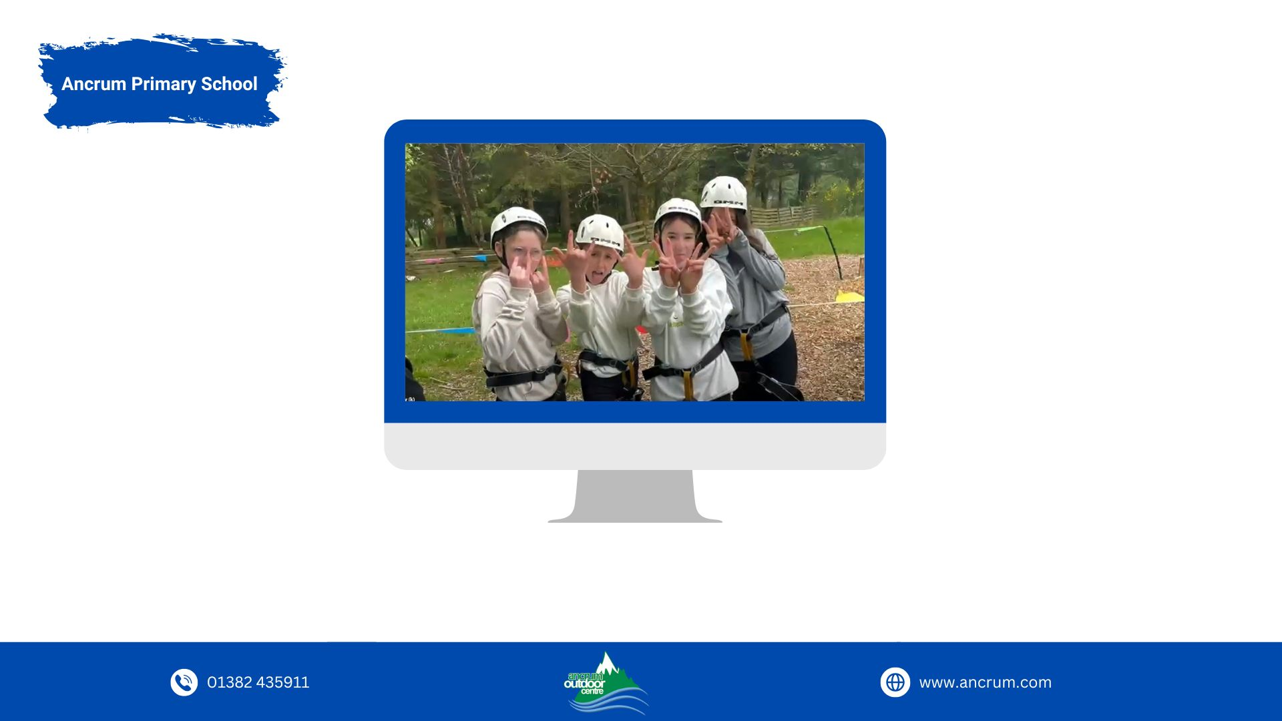
Outdoor Space

