Slide 1
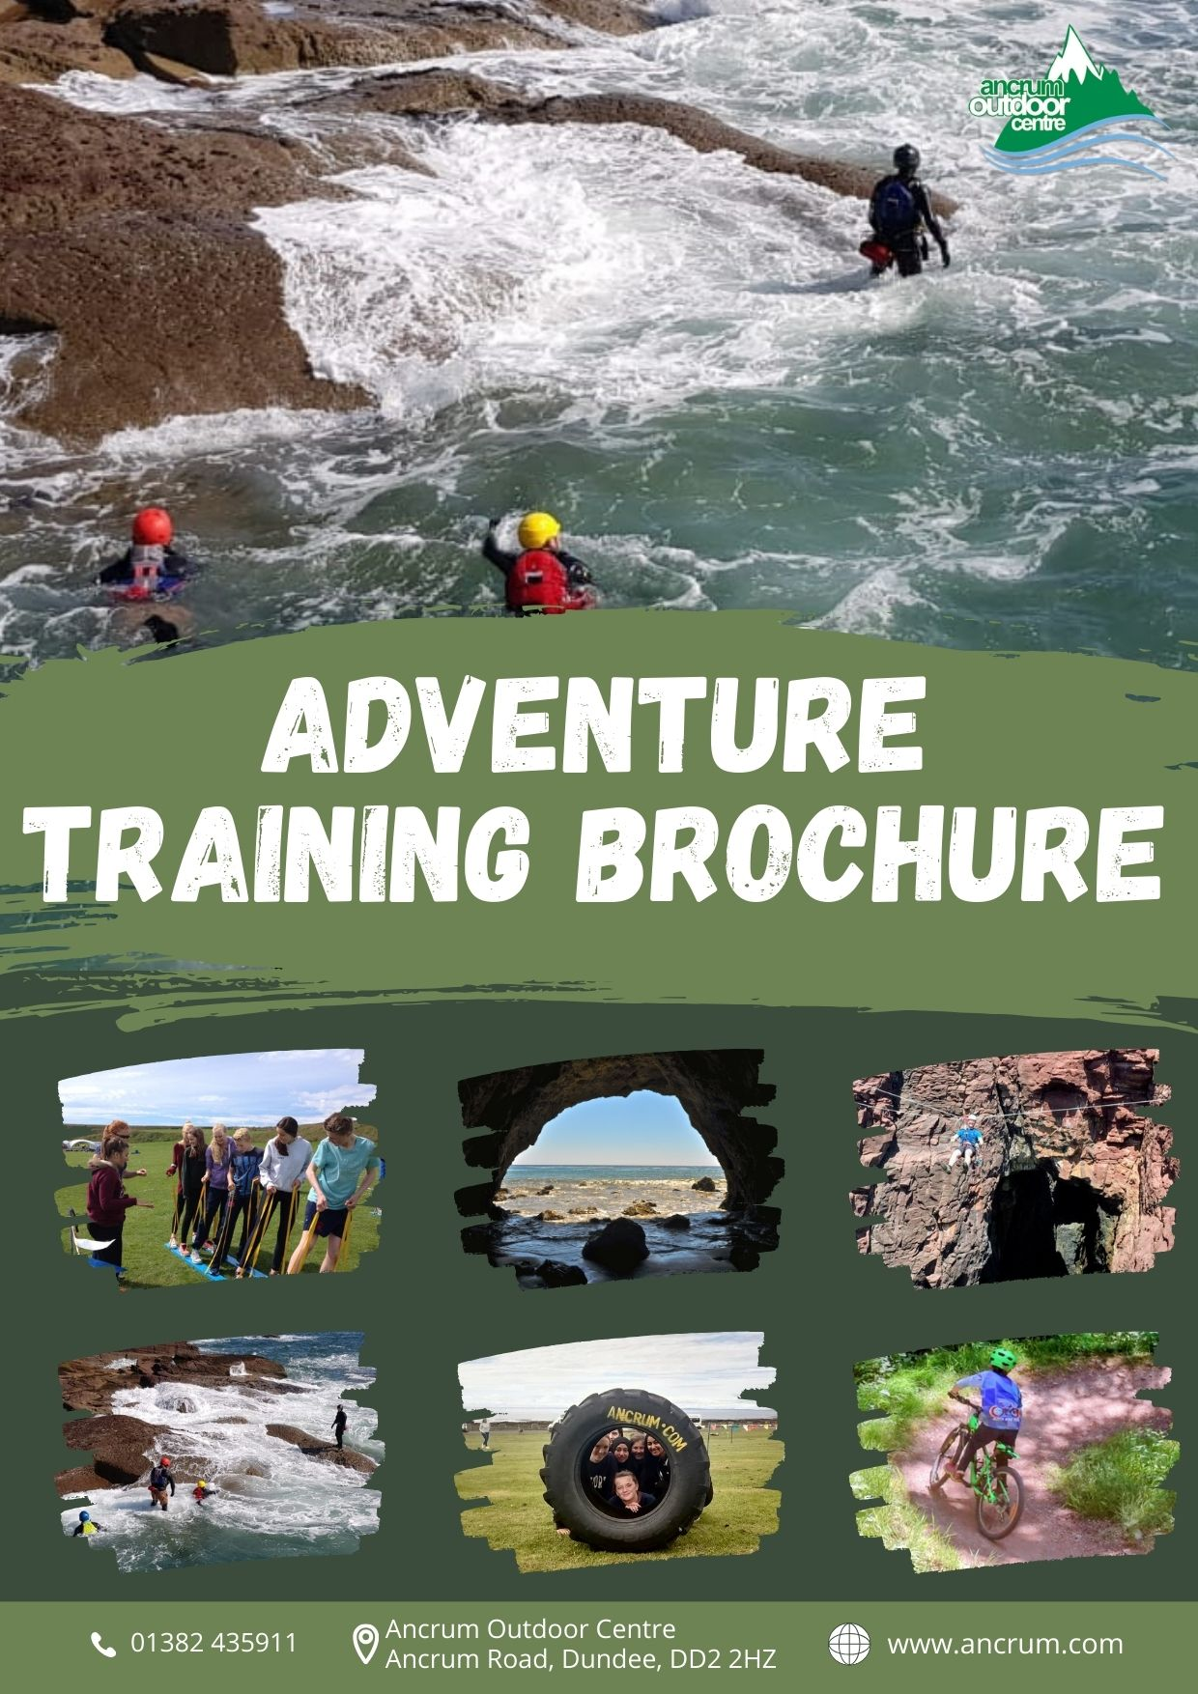

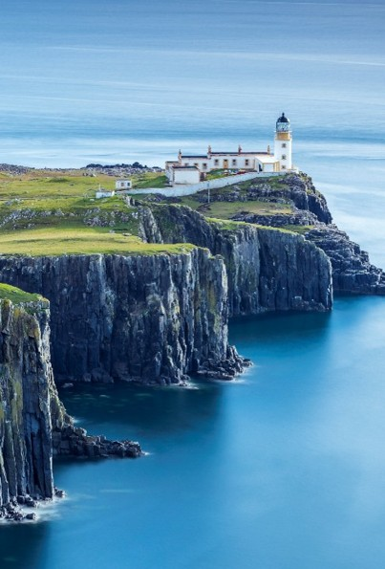
Adventure Training Day

Slide 2
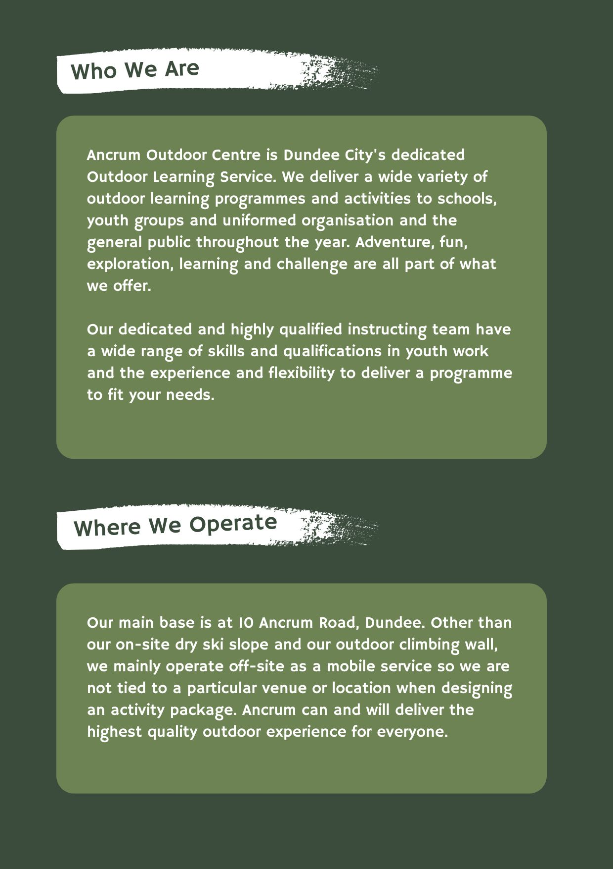
Who We Are

Slide 3

Safety First

Slide 4
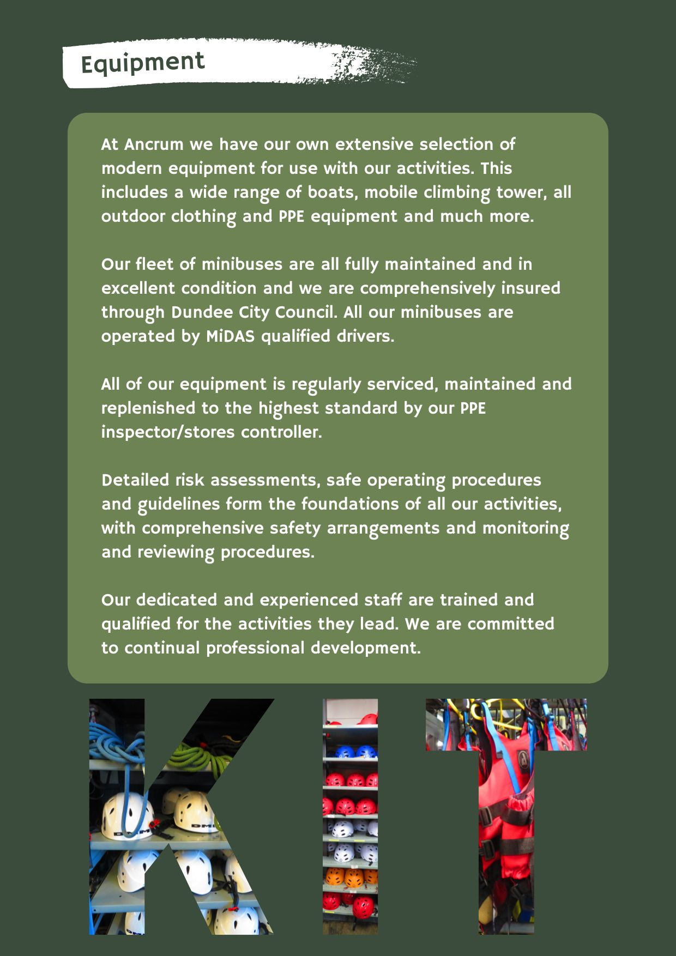
Equipment

Slide 5
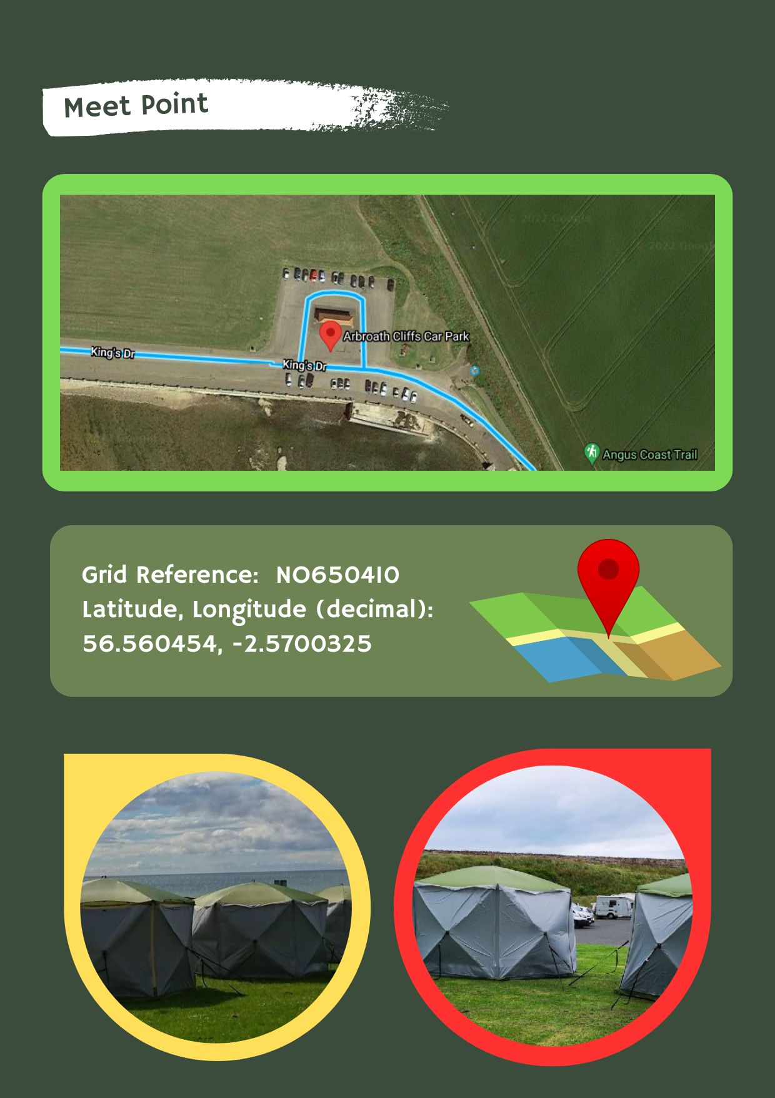
Meeting Point

Slide 6
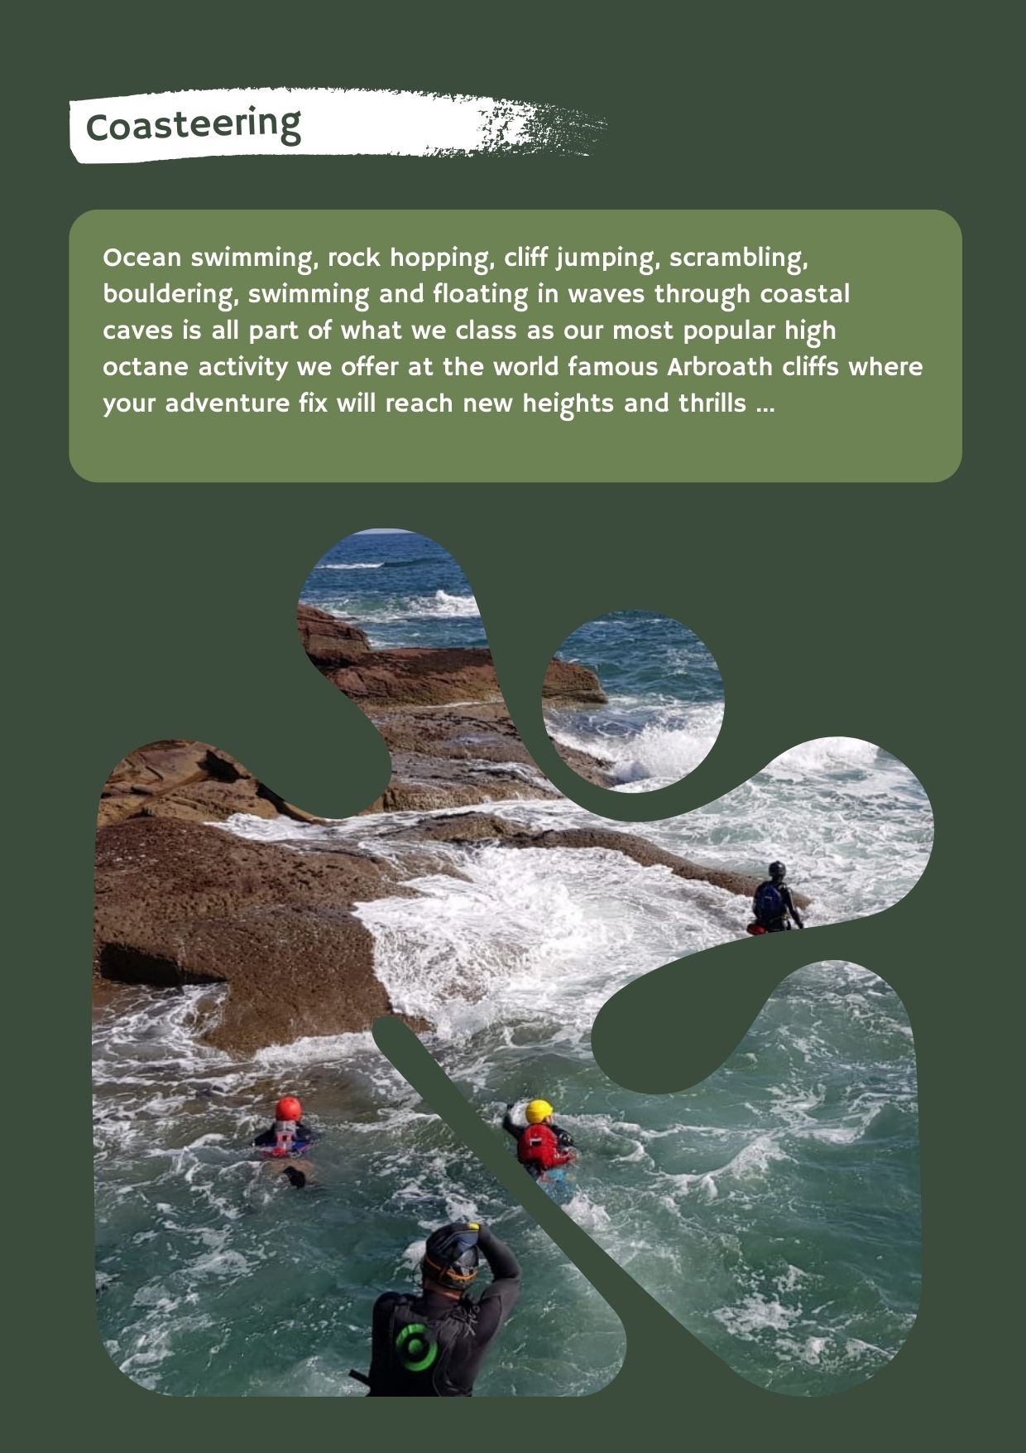
Coasteering

Slide 7
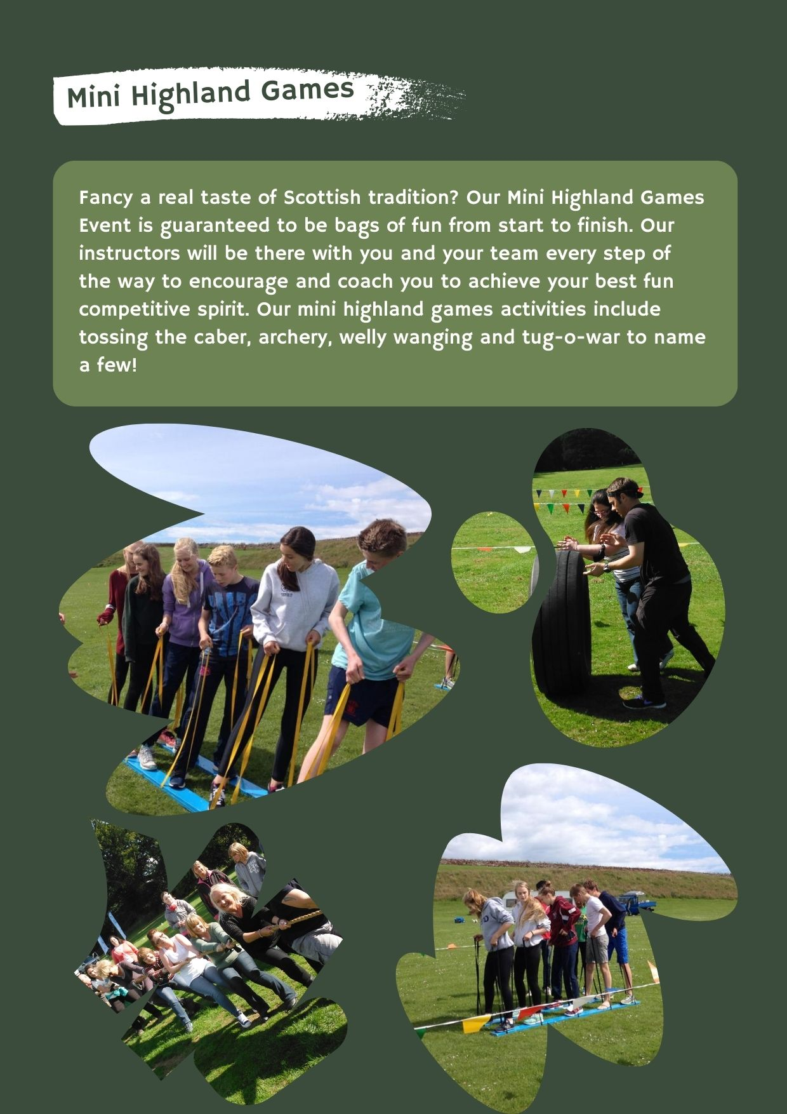
Mini Highland Games

Slide 8
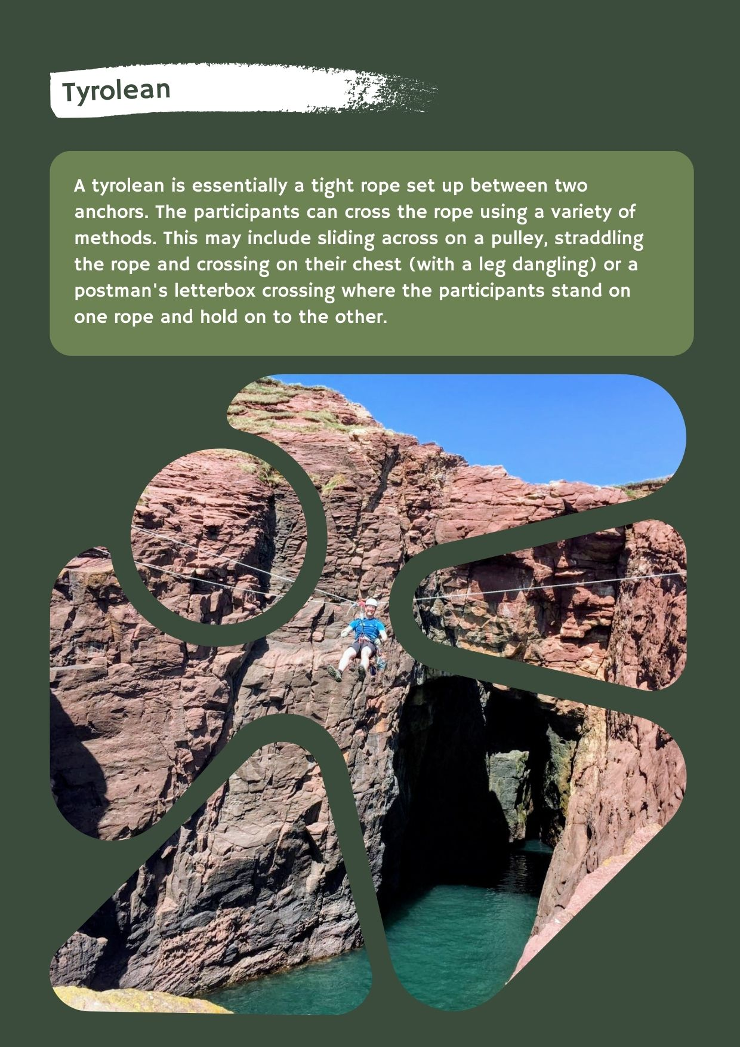
Tyrolean

Slide 9
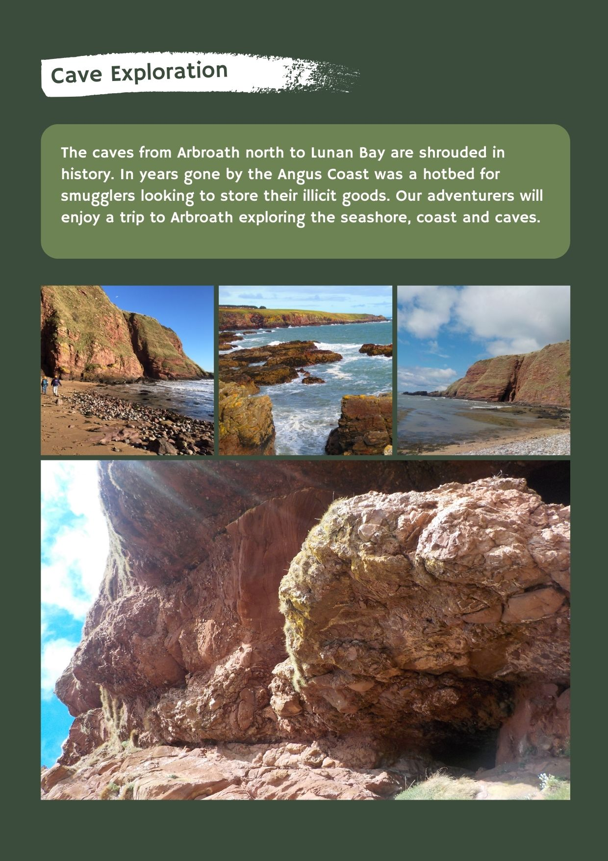
Cave Exploration

Slide 10
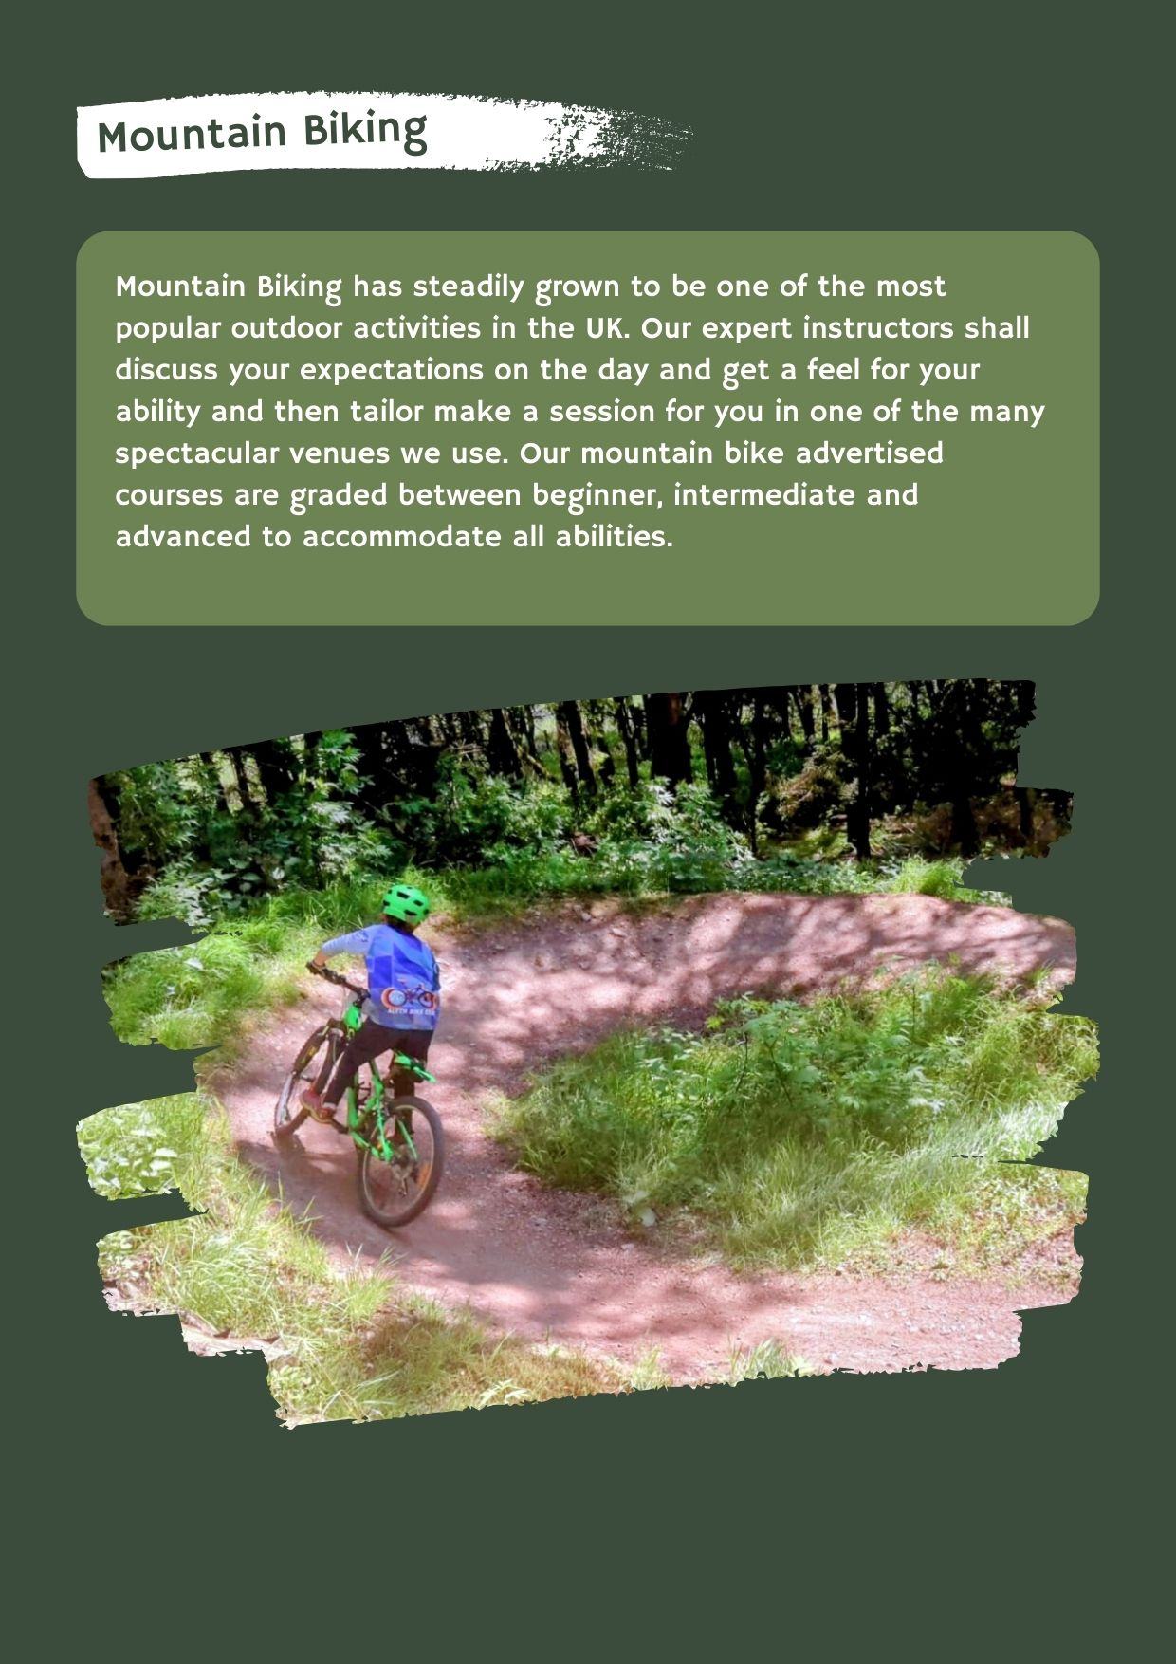
Mountain Biking

Slide 11
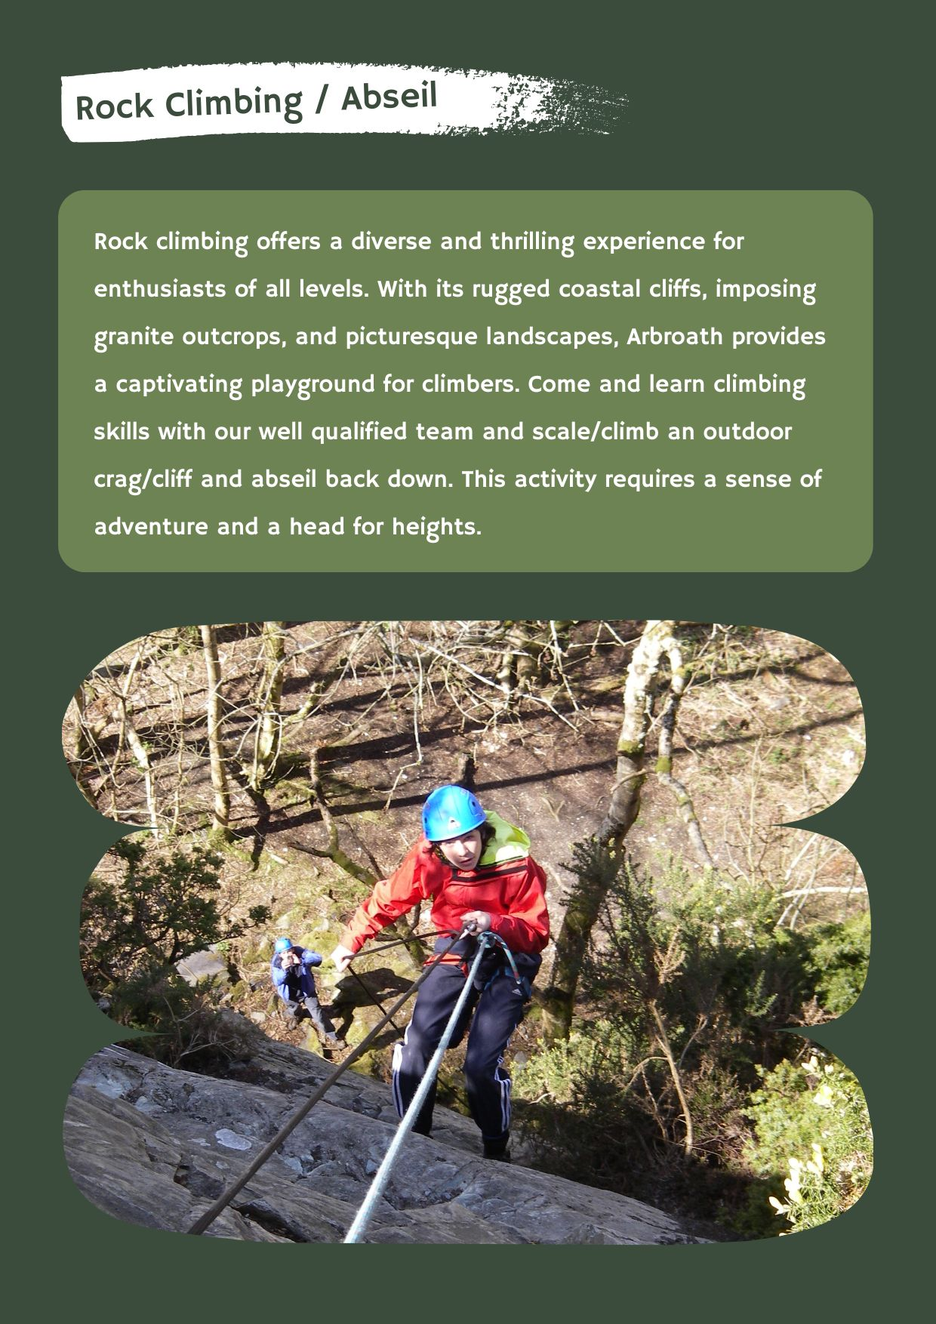
Rock Climbing / Abseil

Slide 12
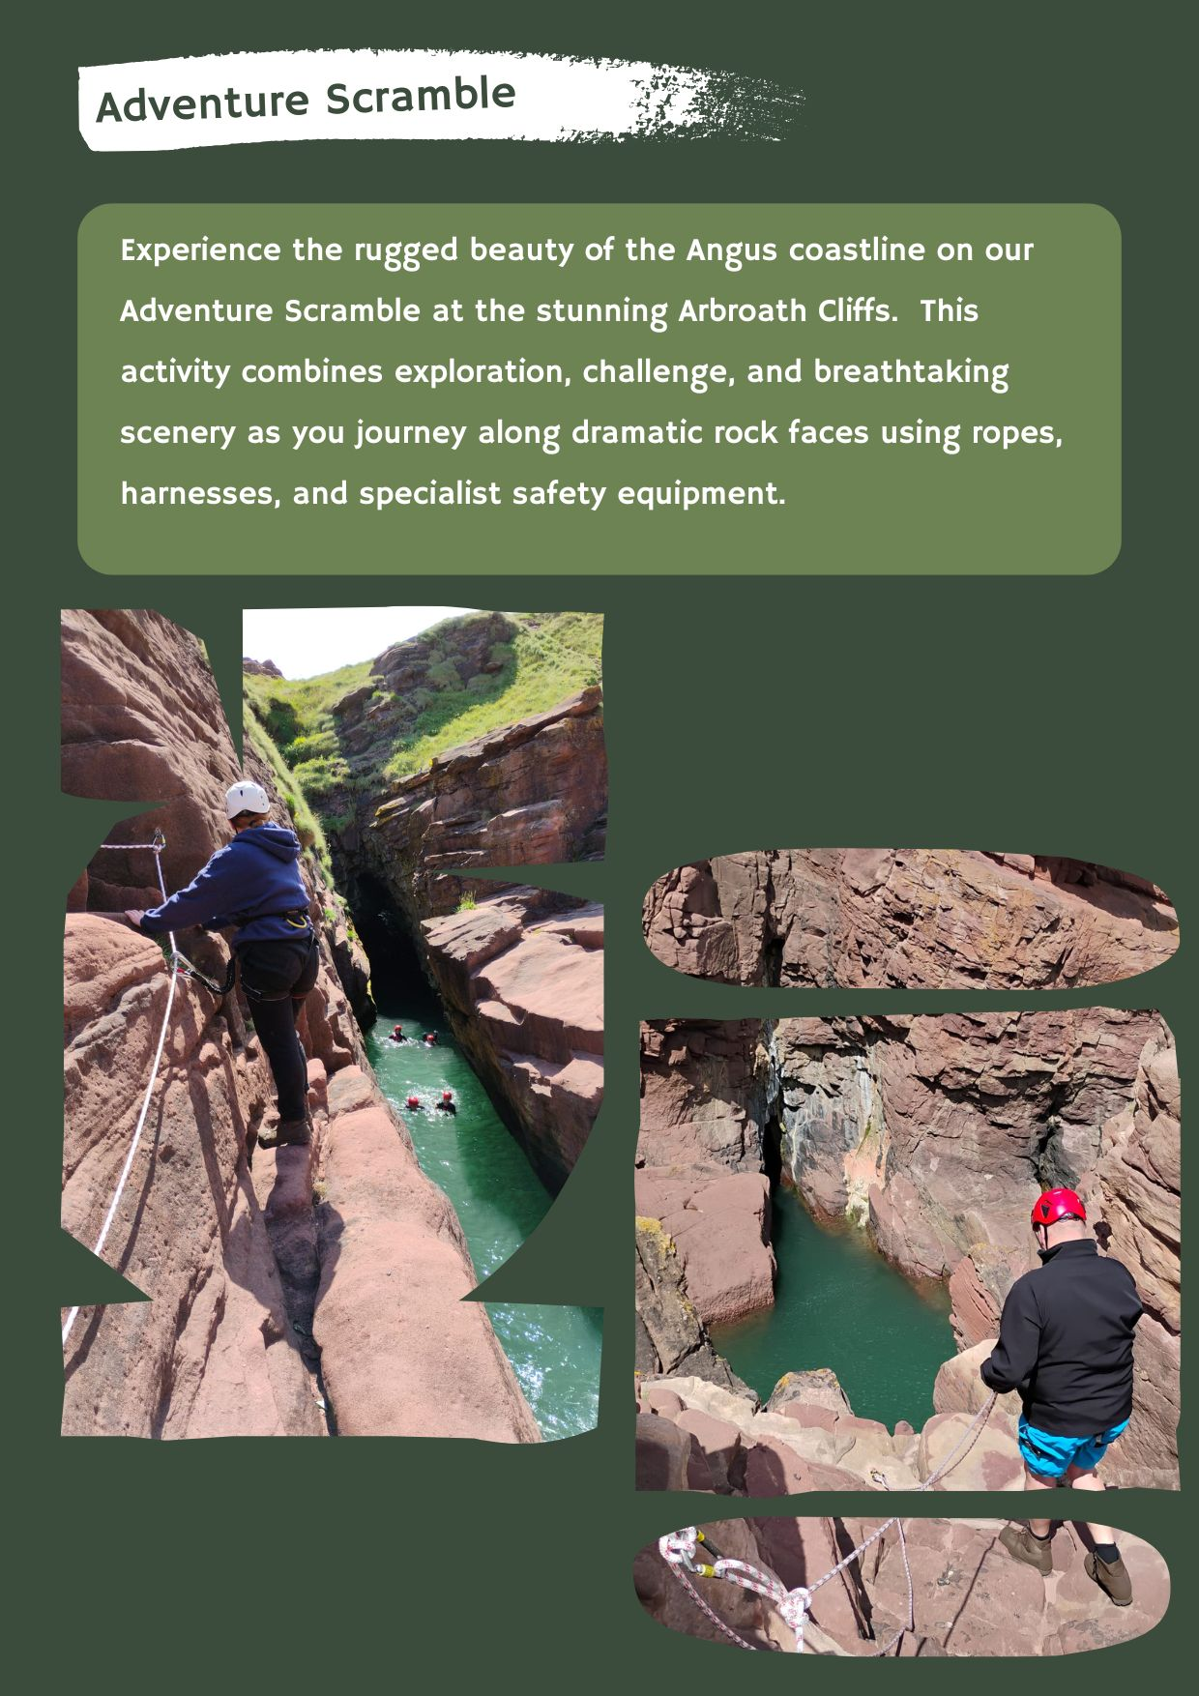
Adventure Scramble

Slide 13
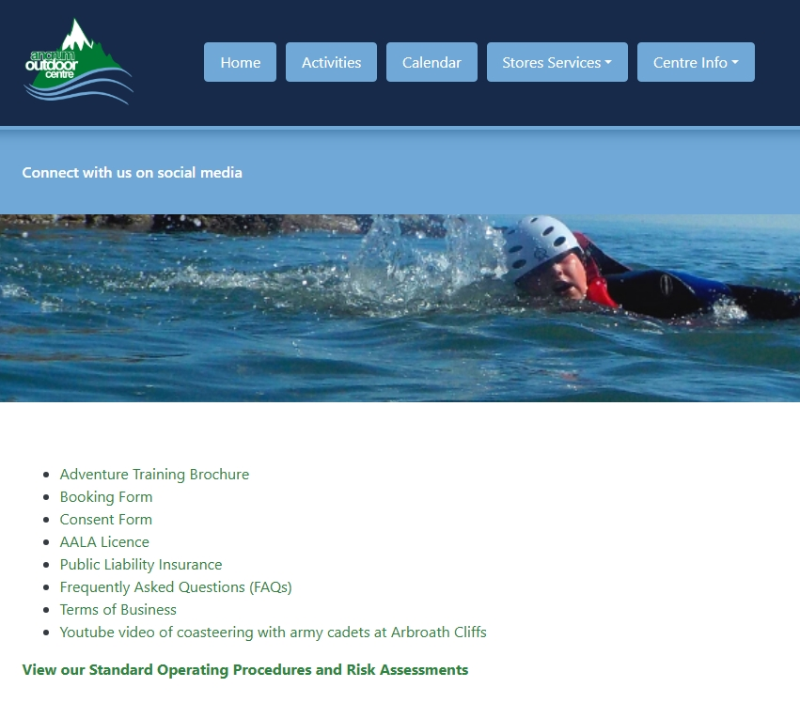
Adventure Training Webpage

Slide 14
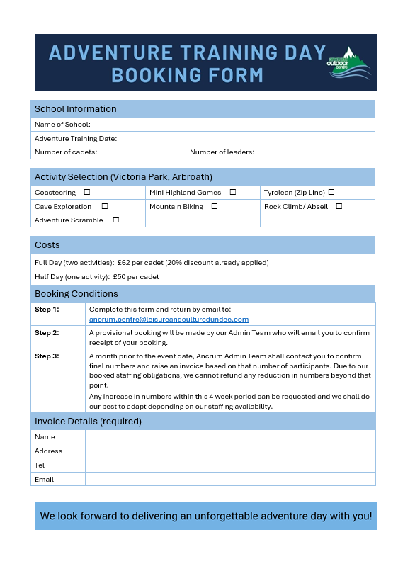
Adventure Training Booking Form

Slide 15
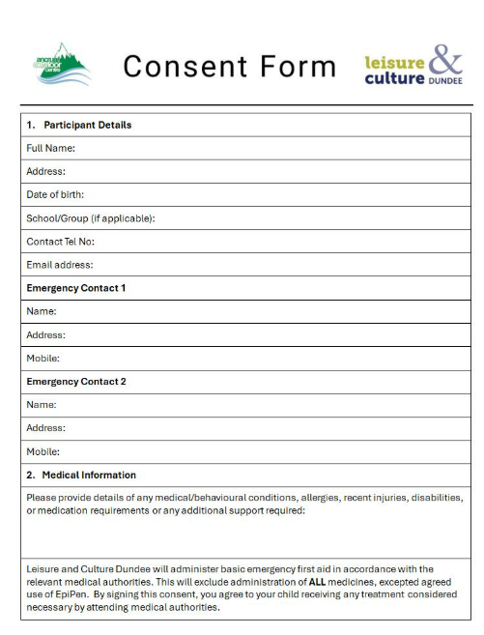
Consent Form

Slide 16
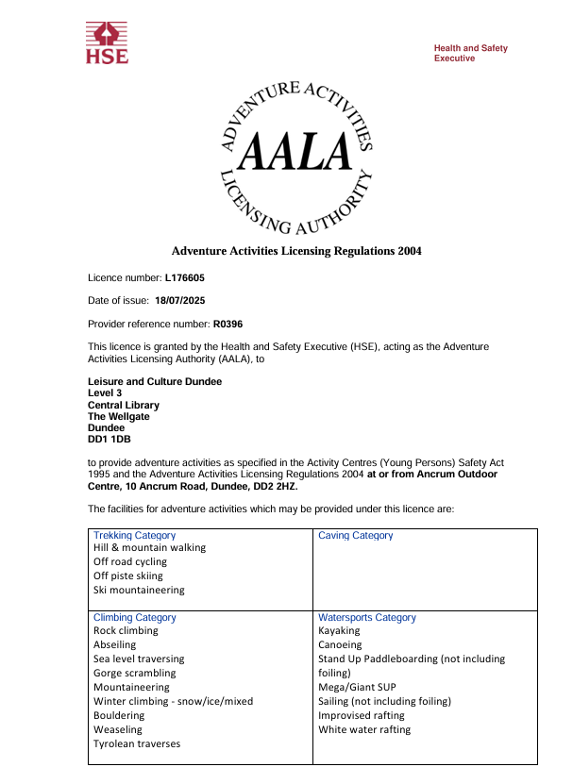
AALA Licence

Slide 17

Public Liability Insurance

Slide 18
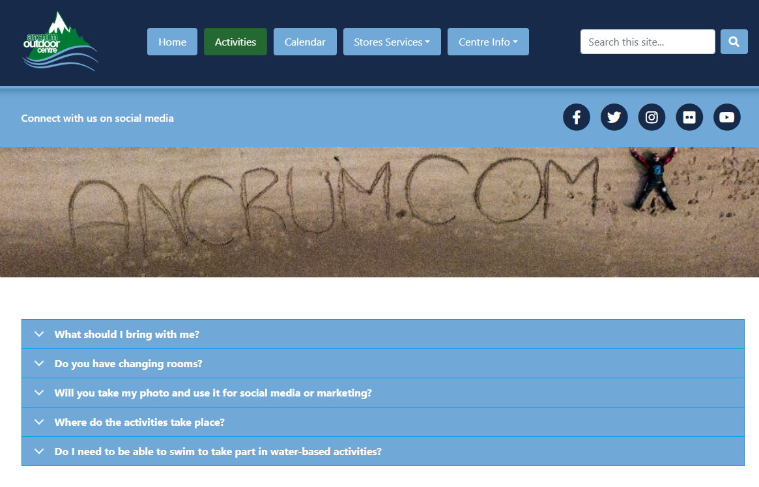
Frequently Asked Questions

Slide 19
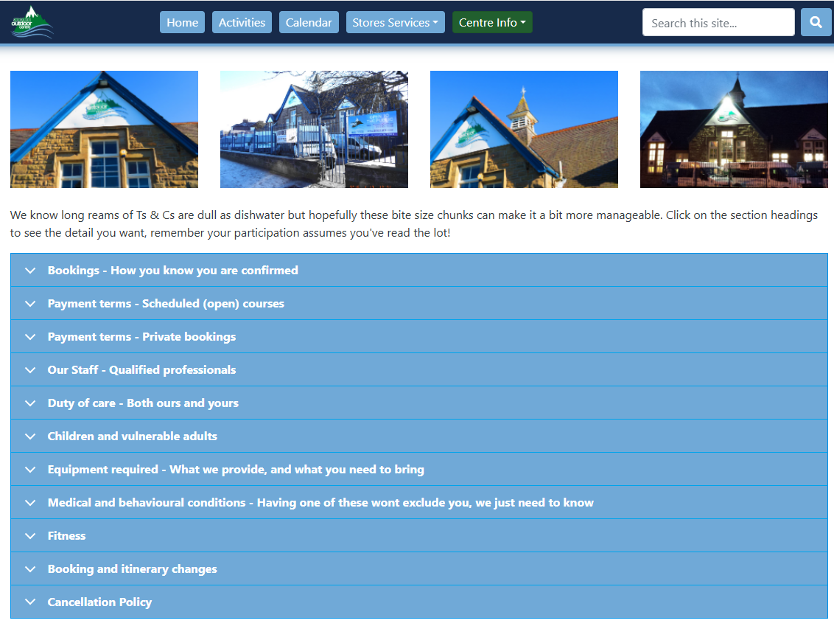
Terms of Business

Slide 20
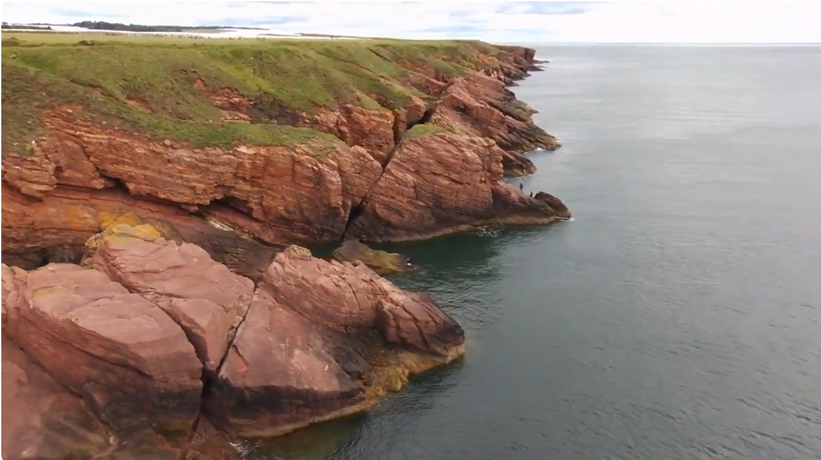
Coasteering with Army Cadets at Arbroath Cliffs
https://www.youtube.com/watch?v=4bPGkE9HlEQ

Slide 21
